Slide 1
Web Storming Sprint 1
Owen, Alex, Samantha, Mo, Antonio
Notes:
sent

Slide 2
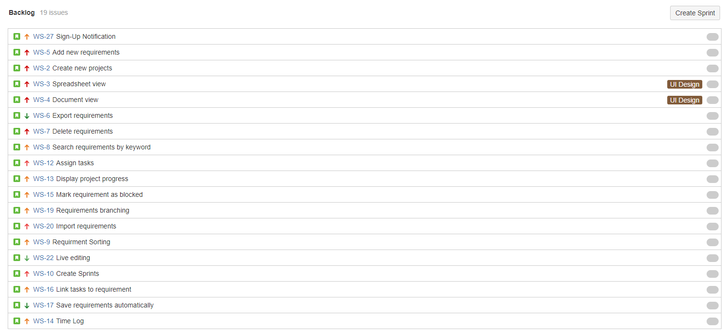
Product Backlog

Slide 3
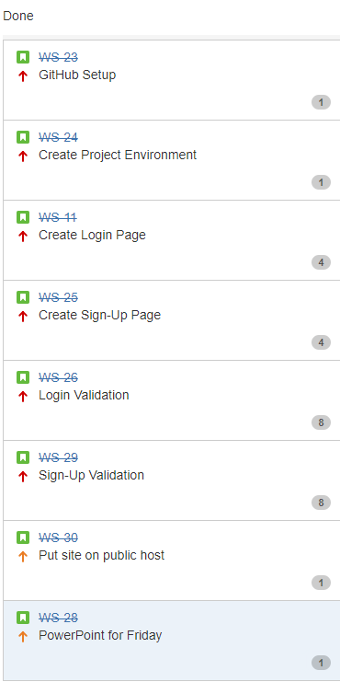


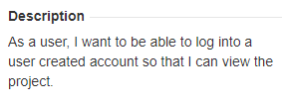




Sprint Tasks

Slide 4
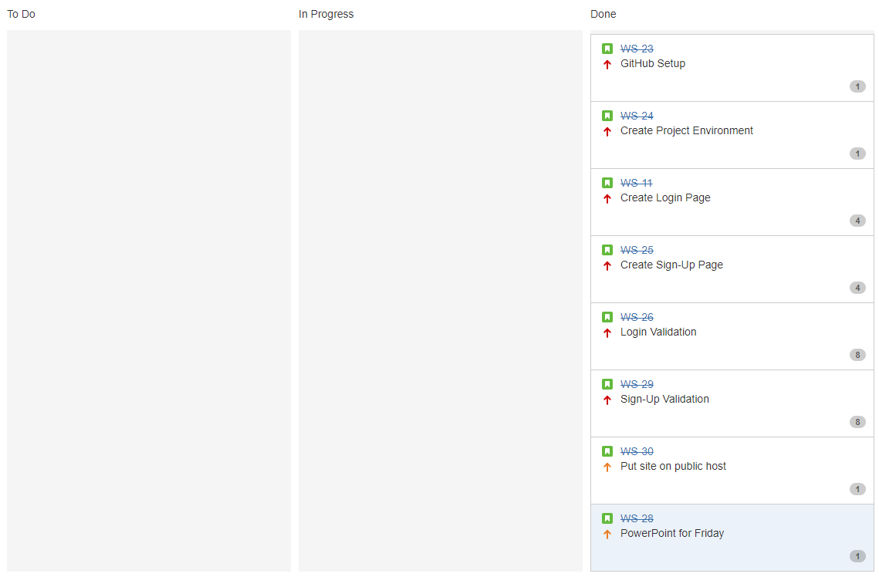
Scrum Board

Slide 5
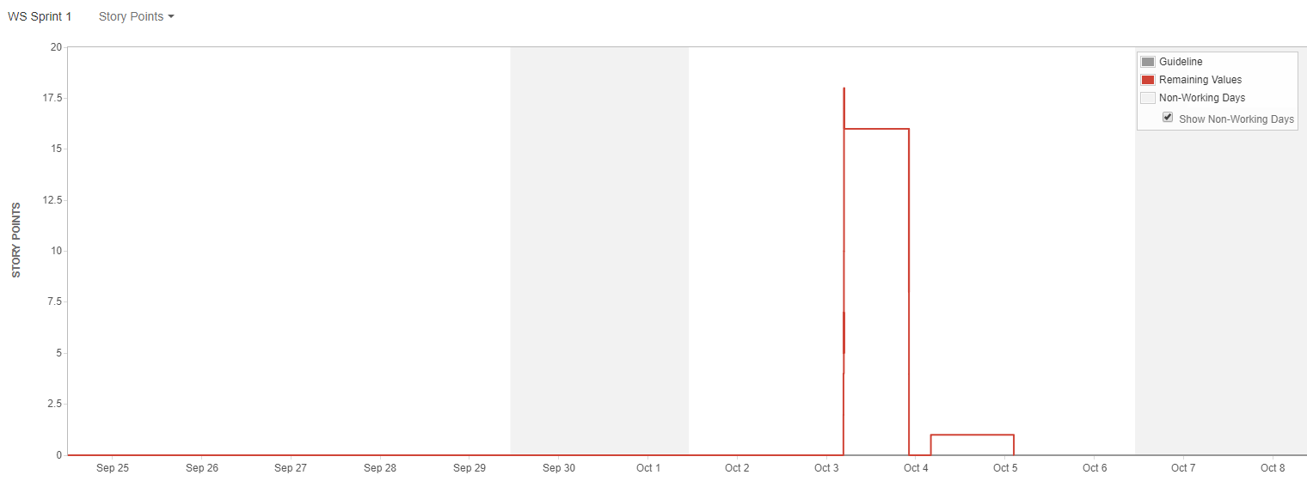
Burndown Chart

Slide 6
Features
Menu Bar
Log In page
Sign Up page
Home Screen

Slide 7
Live Demo
https://requirementstool.netlify.com/

Slide 8
Problems
Meeting Times (Busy Bees)
Initial learning
Version Control
SVN
Git
BitBucket
Interoperability
Future GUI Design
Avista
Platteville
Lack of customer expectations/needs
Notes:
Meeting Times - Discord (work from home), compromises on fun time, working on our own, taking notes during meetings and posting them on slack.
Initial learning -
Version Control - SVN is a software versioning and revision control system. Git is a Distributed version control with Peer-to-Peer approach.
Interoperability -
Future GUI- do we do what we want to does avista have an idea of what they want. What software does avista use, and what does it look like. We should base it on the software they use so that the learning curve is less.
Customer expectations - What do they want, how do they want it to look, these feel wishy washy and not really deffined

Slide 9
Questions?

